Slide 1
Best practices of Pair Programming and Code Review
By Sumana Saha, Software Engineer at RatePAY GmbH

Slide 2
Agenda
Industry trends in Software Development.
“Peer programming” what is this new buzz word about?
“Pair Programming” – why we need / How to do it ?
“Code Review” – How & Who reviews the code ?
Best practices – Takeaways
Questions and Discussions ?

Slide 3
Before everything let‘s See Some Statistics!

Slide 4
IBM reported spending about “$250 million repairing and reinstalling fixes to 30,000 customer-reported problems”. Pair programming significantly reduces these expenses by reducing the defects in the programs.
Source:IBM official website

Slide 5
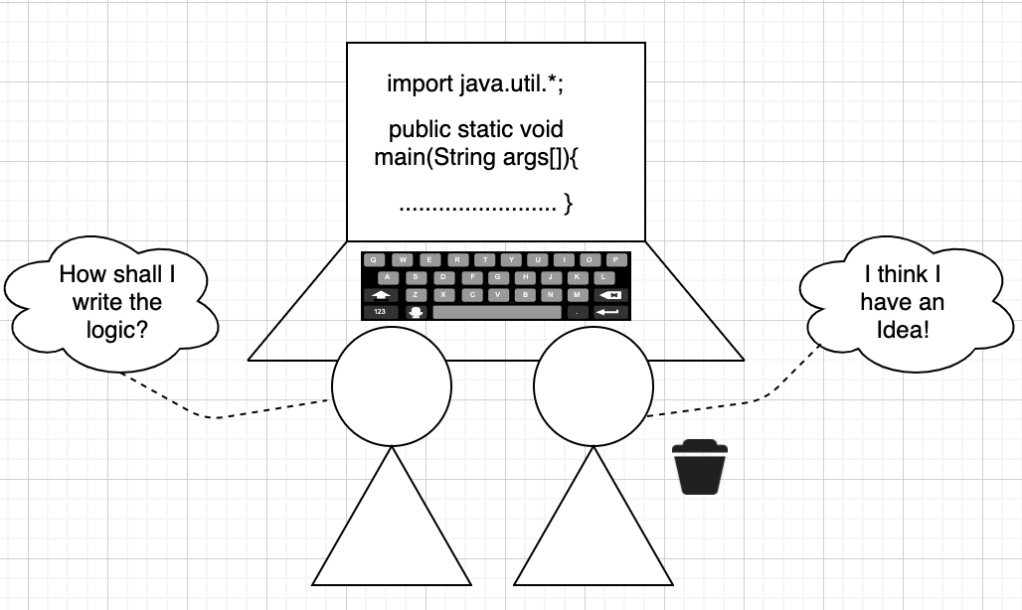
„Buzz word“ PAIR Programming!
Notes:
Pair/Peer programming is an agile software development technique in which two programmers work together at one workstation.

Slide 6
Agile Software Development & Pair Programming
The importance of agile is that it focuses on empowering people to collaborate and make decisions together quickly and effectively. Pair programming takes collaboration to the next level for developers.

Slide 7
When this technique was first used?

Slide 8
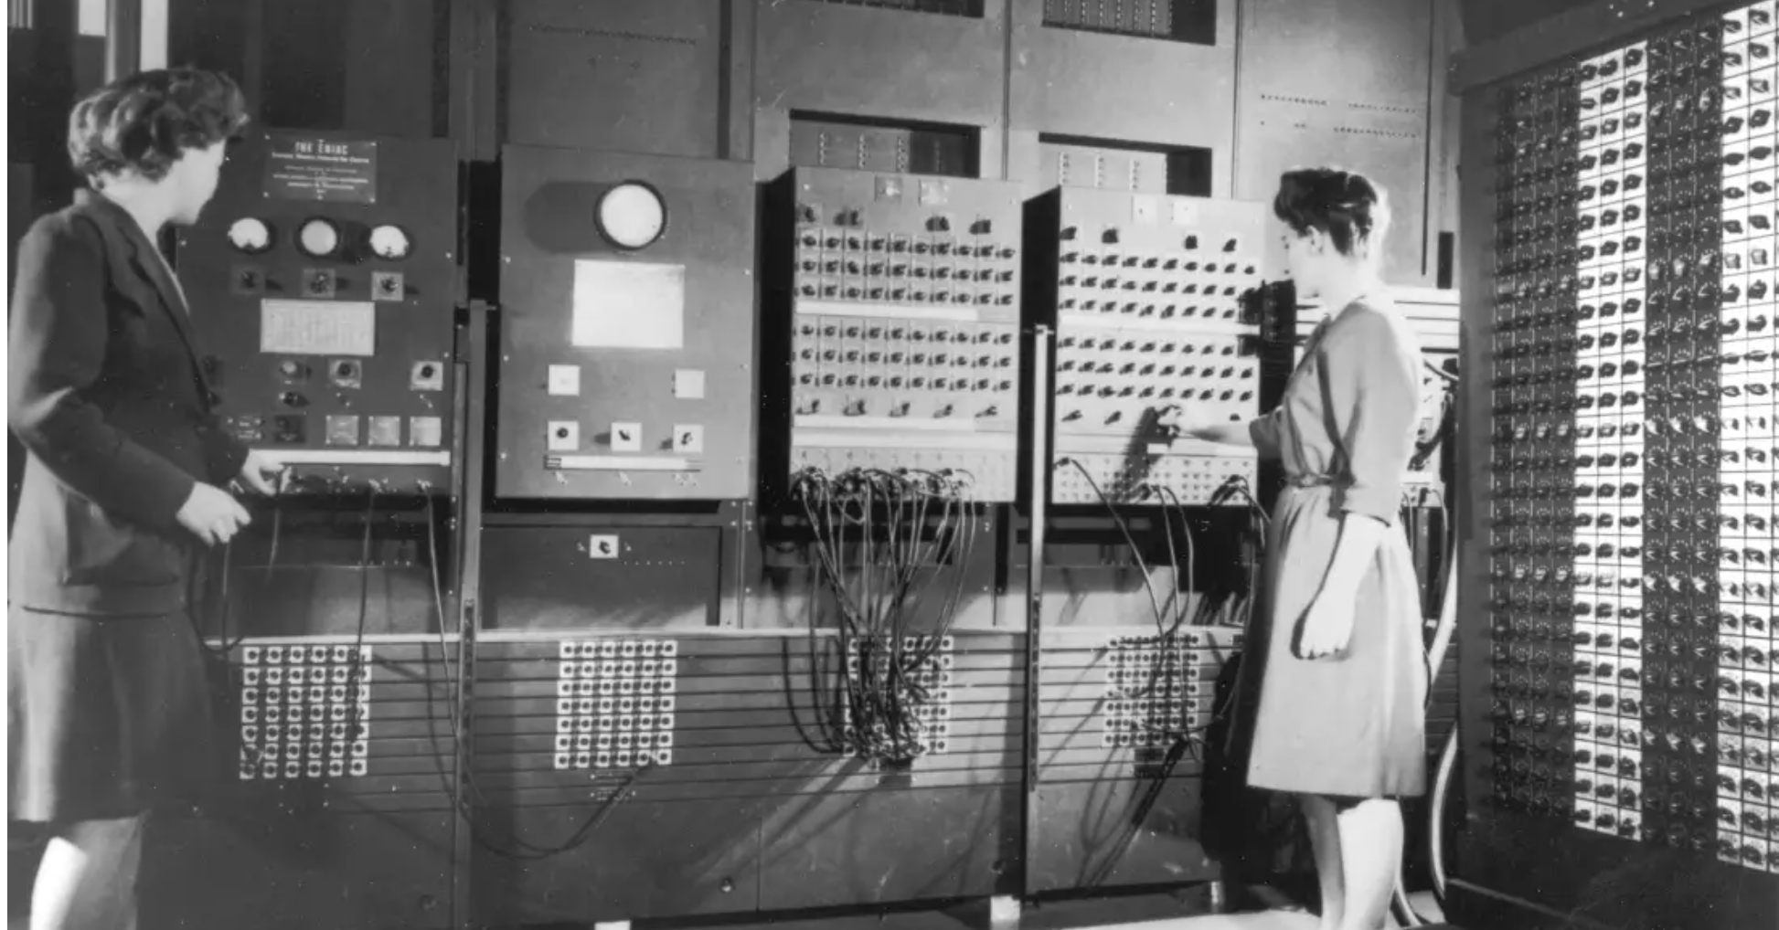
The Refrigerator Ladies(From left Jean Bartik, Betty Snyder) ENIAC Programmers in 1940
Image Source:www.google.com

Slide 9
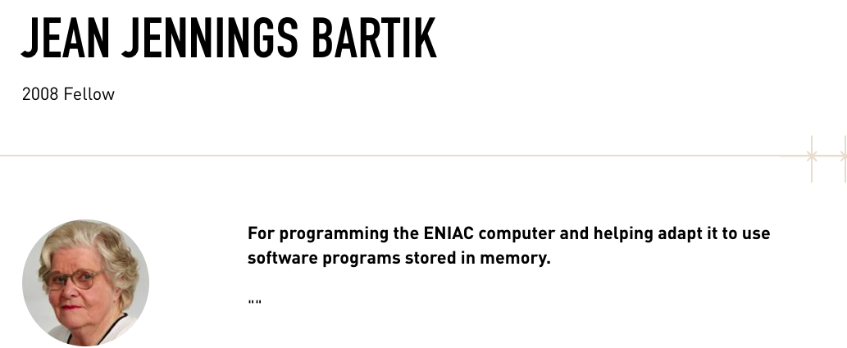
Betty Snyder and I, from the beginning, were a pair. And I believe that the best programs and designs are done by pairs, because you can criticise each other, and find each others errors, and use the best ideas.
Image Source:www.google.com

Slide 10

Pair Programming
Kent Beck, an American software engineer who originally coined the term in the late 1990s and described two programmers working at different levels of abstraction. He is also known for his book „Test-Driven Development by Example“
Image Source:www.google.com

Slide 11
How to make this work?
Choose the pairing variation
Decide the pairing style

Slide 12
Variations of Pair programming
Expert – Expert
High productivity | New approach to solve a problem
Expert – Novice
Mentor mentee relationship | Out of the box ideas
Novice – Novice
Produces significantly better result than working independently

Slide 13
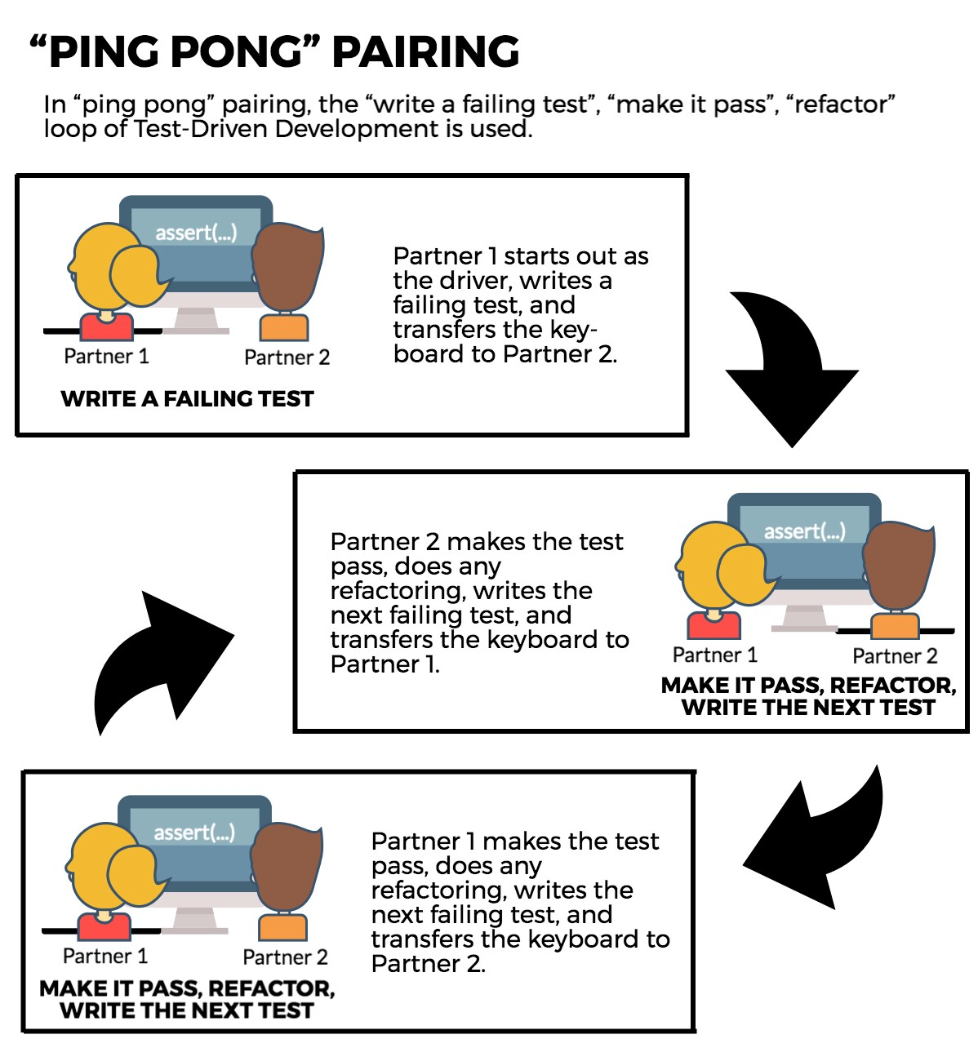
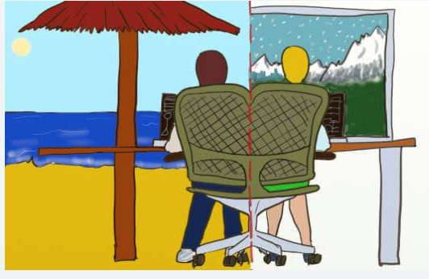
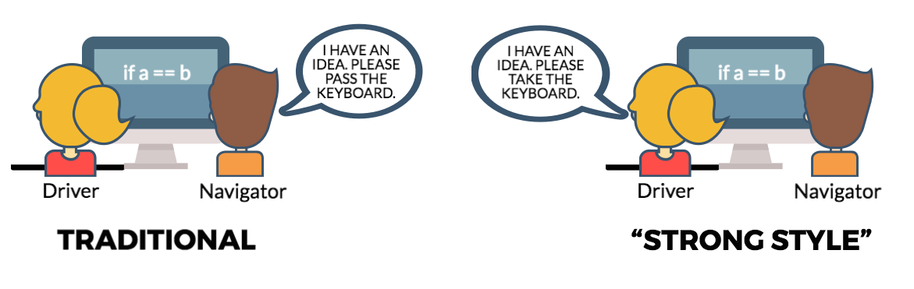
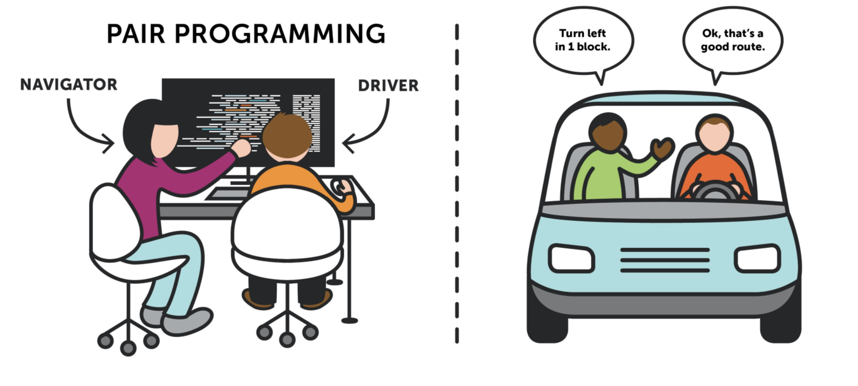
Styles of pair programming
Driver – Navigator
Strong – Style
Ping – Pong
Remote pairing ( Best for the present COVID19 situation )

Slide 14
Look and Feel of pair programming!

Slide 15
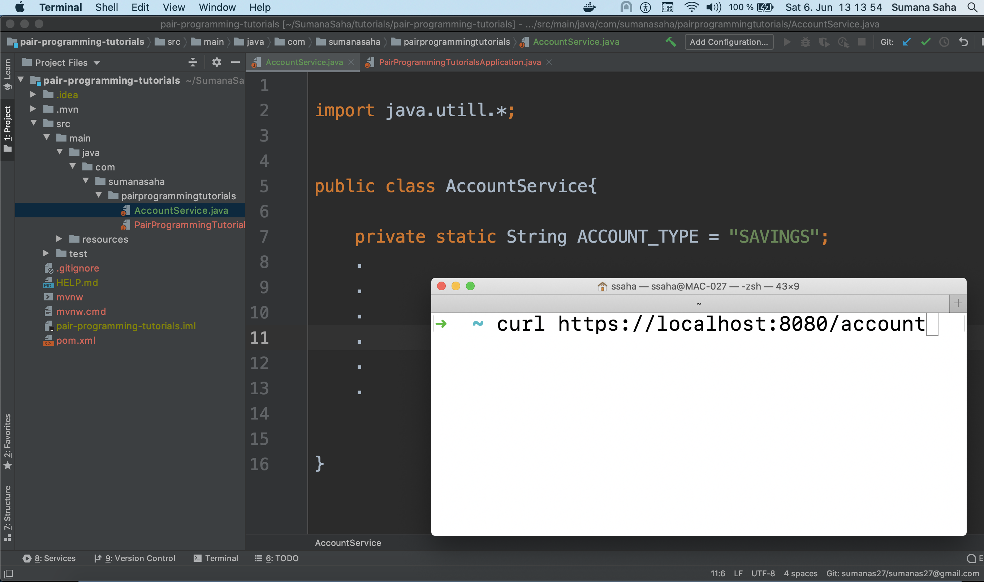
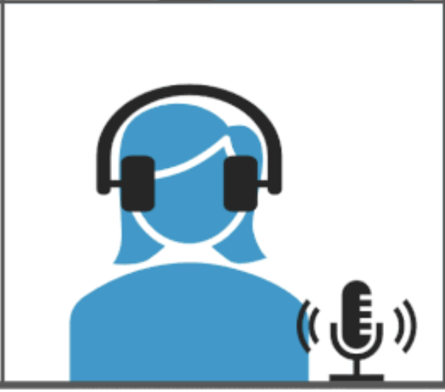
Notes:
Use case with Combination of Driver – Navigator and Remote Programming , Driver : Code Author Navigator : Remotely as pair
The Goal here is to write a service class named „AccountService

Slide 16
How to proceed now ?
Using video to see pairing partner‘s facial expressions or gestures
Planning and executing for the Goal decided before starting to code
Writing codes
Testing back and forth on the development
Pairing partners agree upon the solution
Screen sharing and controlling the code via Video Conferencing tools ( e.g. Microsoft Teams, Cisco Webex etc )

Slide 17
Things to remember before starting
What will happen when the solution goes to the common code base?
Code Collision!

Slide 18
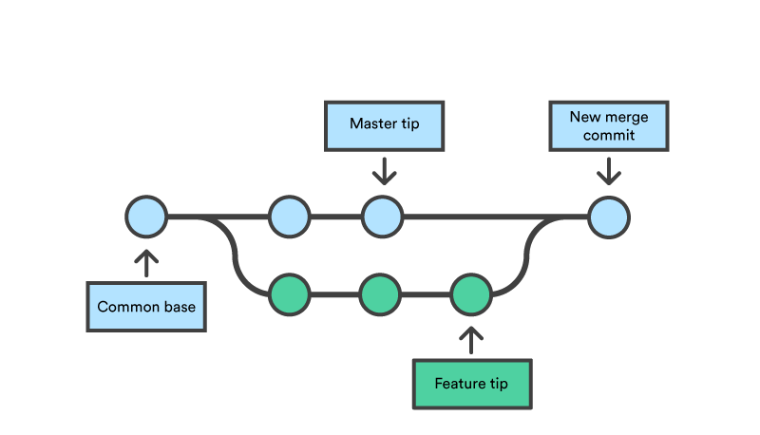
Git / GitHub comes here to rescue us
Code repository
Notes:
Include Git workflow for implementing the first file

Slide 19
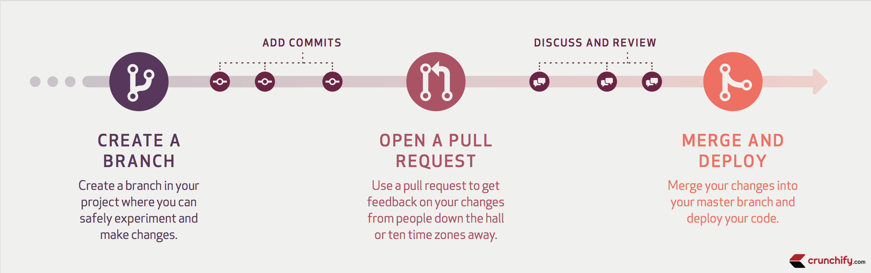
We are ready with our solution. What to do now?

Slide 20
Let’s take a step back and think that do we had any problem on pairing?

Slide 21
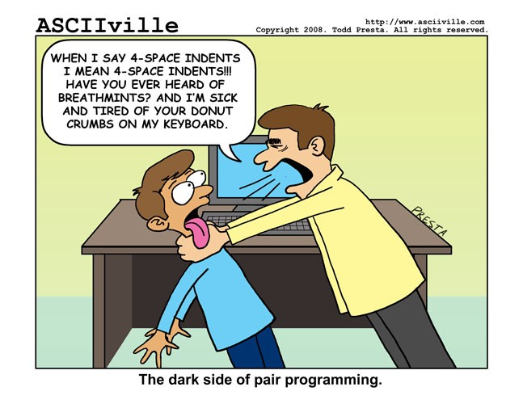

Slide 22
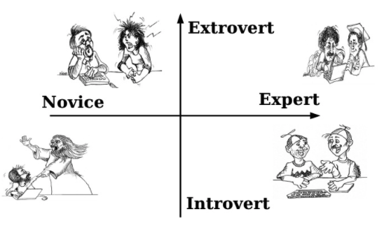
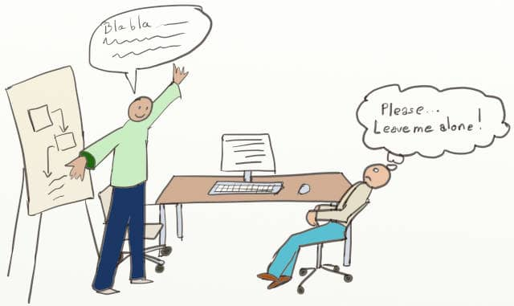
Common Pitfalls
Compatibility Issues
Lack of willingness to do pairing
More talk, Less code
Lack of Courage
Loss of confidence
Insecurity complex

Slide 23
How to solve the problem?

Slide 24
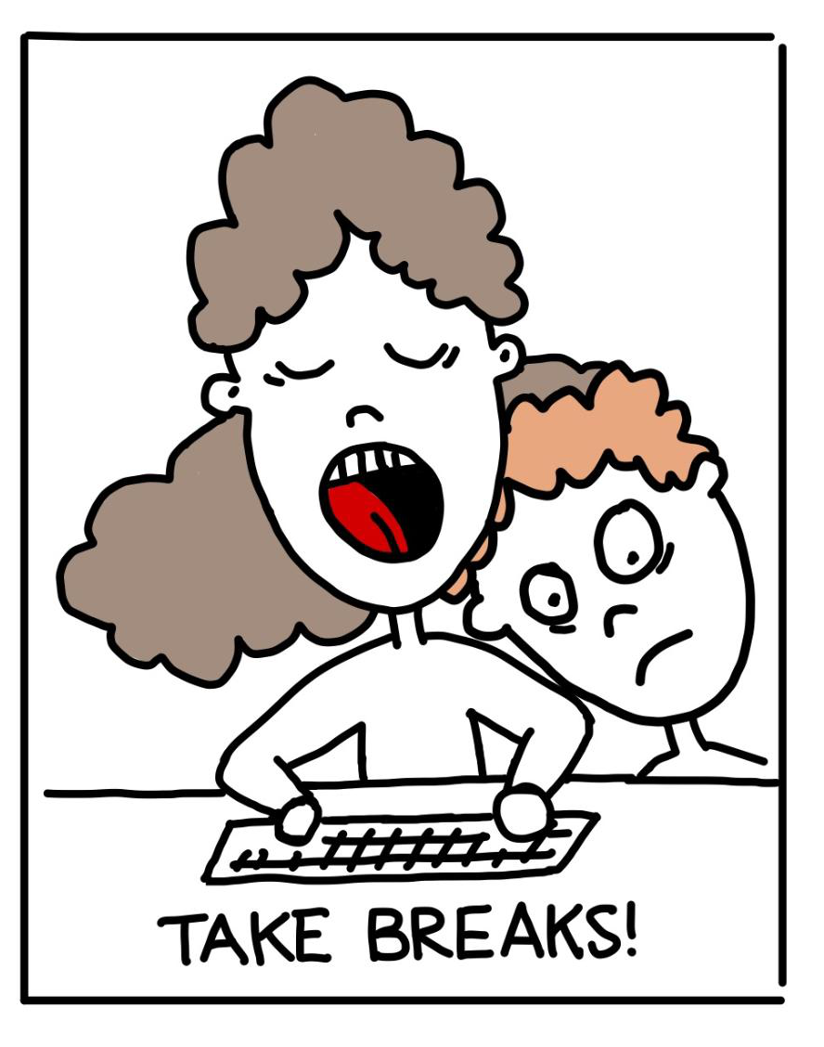
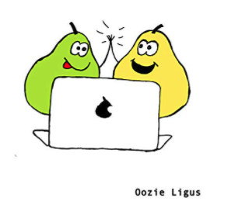

Best Practices
Trust your Instinct
Research together with partner
Break the problem into smaller chunks
Put validation on each idea shared by pairing partner
Take breaks
Be humorous and open

Slide 25
How to let your Team know about your Solution?

Slide 26
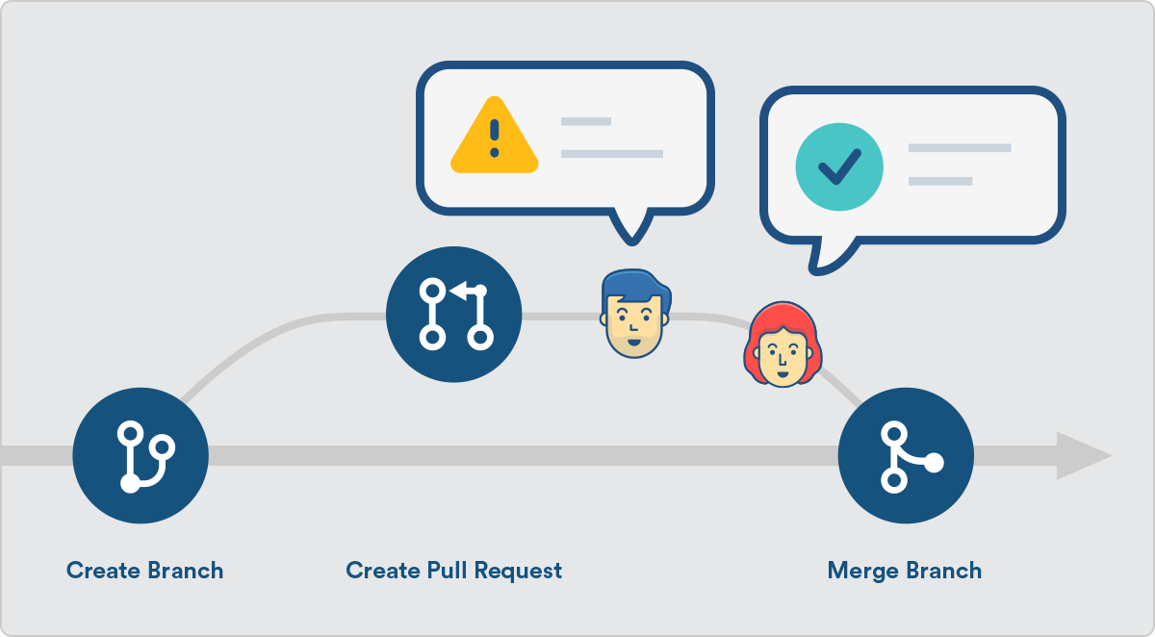

Slide 27
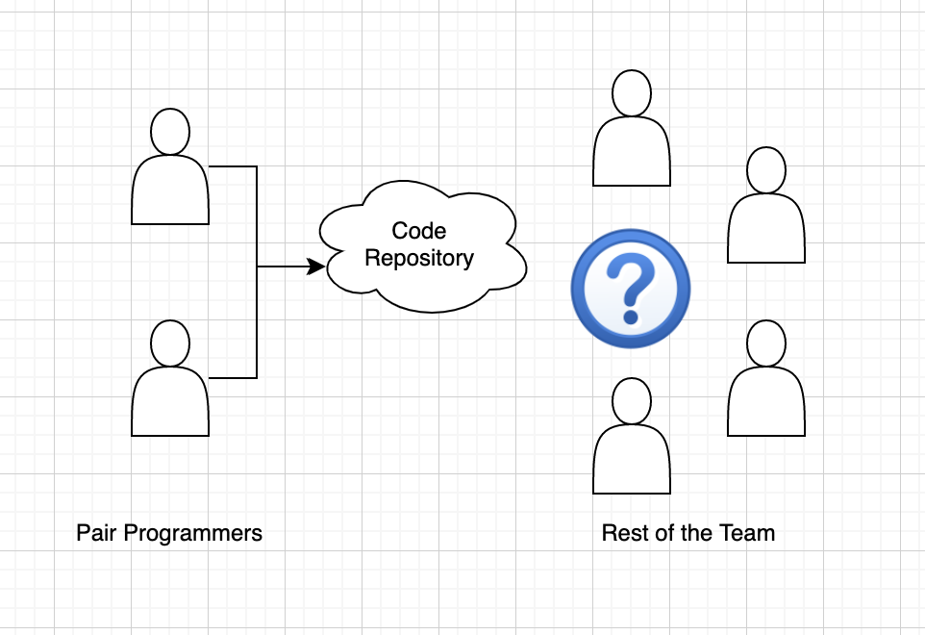
What‘s Next ?
Now it is the time for CODE REVIEW!!

Slide 28
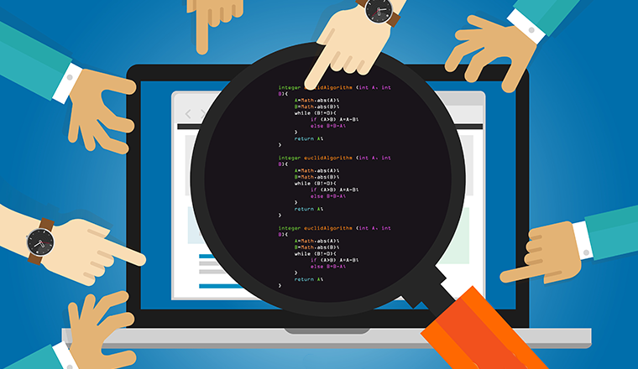
What is Code review ?

Slide 29
Code review is an act of software quality assurance in which one or several people take part and check the piece of code for correctness.

Slide 30
Code review control flow
Developed code is ready to be reviewed
Code Authors sent invitation around the Team via Email / Tool used to create Pull request
Reviewers review the code and provide feedback to the code author
If there are no open questions, Pull request is marked as “Approved” and it is ready to be merged in the Code repository.

Slide 31
How to review a Code?

Slide 32
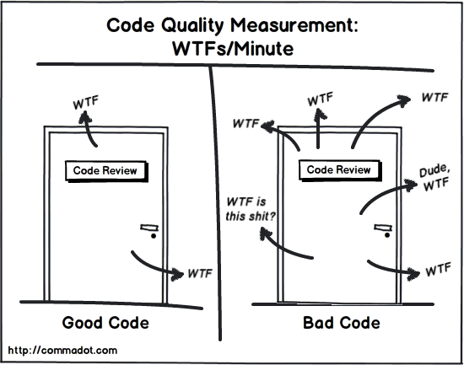

Slide 33
Define a Checklist!
Common guideline is established in the team
Get the context of the code before reviewing
Is there any Bad Code Smells?
Is the Code Readable and correct performance wise?
If there is uncertainty , ask the code author and don’t give approval

Slide 34
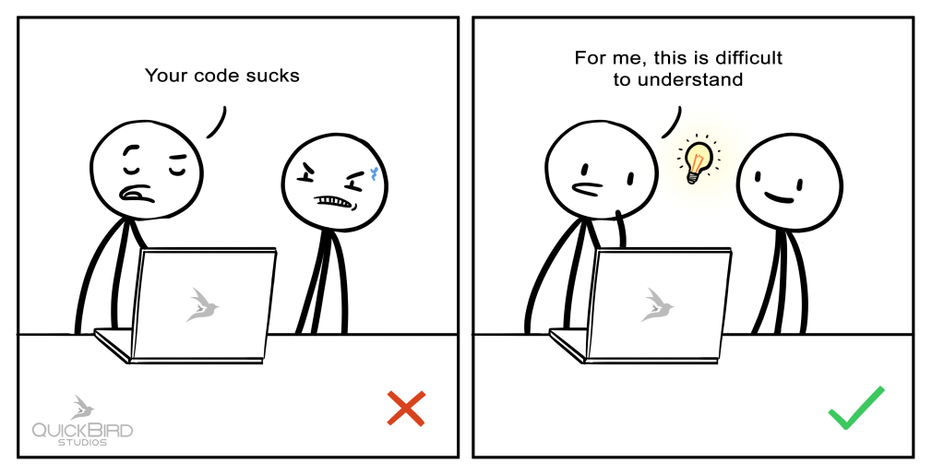
Let’s talk about the Best Practices!
Give respectful and constructive feedback
Connect with the Code Author if necessary
Always explain why the code change / implementation is rejected
Use an IDE ( Eclipse , Intellij IDEA ) for reviewing
Avoid big comment thread for discussing issues

Slide 35




Who are practicing Pair-Programming & Code Review?
And many others….

Slide 36
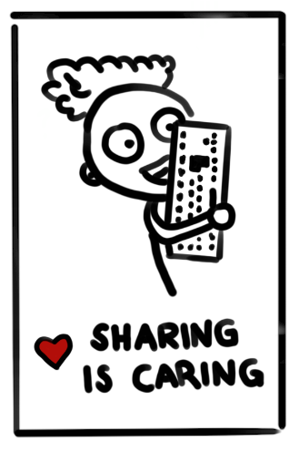
Takeaway!
Collaborate with team members. Do not compete, it is not a HACKATHON!

Slide 37
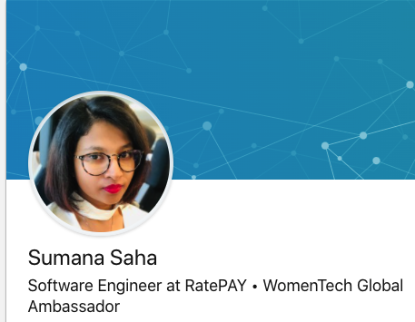
Useful resources
https://martinfowler.com/articles/on-pair-programming.html
https://www.michaelagreiler.com/code-review-book/
https://learning.oreilly.com/library/view/clean-code/9780136083238/
For future connections : https://www.linkedin.com/in/sumana-saha-30148664/

Slide 38
Lets try to discuss the questions in your mind?
- Thank you

